Slide 1
Features of Linux Operating System

Slide 2
Linux
▶ Linux is one of popular version of UNIX operating System.
▶ It is open source as its source code is freely available. It is free to use.
▶ Linux was designed considering UNIX compatibility.
▶ Its functionality list is quite similar to that of UNIX.

Slide 3
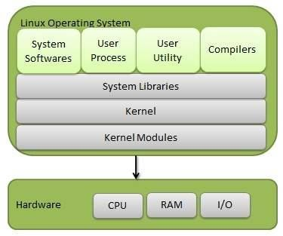
Components of Linux System
▶ Linux Operating System has primarily three components
▶ Kernel − Kernel is the core part of Linux. It is responsible for all major activities of this operating system. It consists of various modules and it interacts directly with the underlying hardware. Kernel provides the required abstraction to hide low level hardware details to system or application programs.
▶ System
functions programs features.
Library − System libraries are special
or programs using which application
or system utilities
accesses Kernel's
These libraries implement most of the
functionalities of the operating system and do not requires kernel module's code access rights.
▶ System Utility − System Utility programs are
responsible to do specialized, individual level tasks.

Slide 4
Kernel Mode vs User Mode
Kernel Mode
▶ Kernel component code executes in a special privileged mode called kernel mode with full access to all resources of the computer.
▶ This code represents a single process, executes in single address space and do not require any context switch and hence is very efficient and fast.
▶ Kernel runs each processes and provides system services to processes,
provides protected access to hardware to processes.
User Mode
▶ Support code which is not required to run in kernel mode is in System Library. User programs and other system programs works in User Mode which has no access to system hardware and kernel code.
▶ User programs/ utilities use System libraries to access Kernel functions to get system's low level tasks.

Slide 5
Basic Features of Linux
Following are some of the important features of Linux Operating System.
▶ Portable − Portability means software can works on different types of hardware in same way. Linux kernel and application programs supports their installation on any kind of hardware platform.
▶ Open Source − Linux source code is freely available and it is community based development project. Multiple teams work in collaboration to enhance the capability of Linux operating system and it is continuously evolving.
▶ Multi-User − Linux is a multiuser system means multiple users can access system resources like memory/ ram/ application programs at same time.
▶ Multiprogramming − Linux is a multiprogramming system means multiple applications can run at same time.
▶ Hierarchical File System − Linux provides a standard file structure in which
system files/ user files are arranged.
▶ Shell − Linux provides a special interpreter program which can be used to execute commands of the operating system. It can be used to do various types of operations, call application programs. etc.
▶ Security − Linux provides user security using authentication features like
password protection/ controlled access to specific files/ encryption of data.

Slide 6
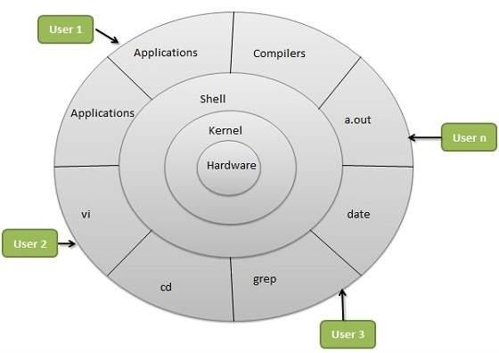
Linux Architecture
The architecture of a Linux System consists of the following layers −
▶ Hardware layer − Hardware consists of all peripheral devices (RAM/ HDD/ CPU etc).
▶ Kernel − It is the core component of Operating
System, interacts directly provides low level services
with hardware, to upper layer
components.
▶ Shell − An interface to kernel, hiding complexity of kernel's functions from users. The shell takes commands from the user and executes kernel's functions.
▶ Utilities − Utility programs that provide the user most of the functionalities of an operating systems.

Slide 7
OS services
An Operating System provides services to both the users and to the programs.
▶ It provides programs an environment to execute.
▶ It provides users the services to execute the programs in a convenient manner.
Following are a few common services provided by an operating system −
▶ Program execution
▶ I/O operations
▶ File System manipulation
▶ Communication
▶ Error Detection
▶ Resource Allocation
▶ Protection

Slide 8
Program execution
▶ Operating systems handle many kinds of activities from user programs to system programs like printer spooler, name servers, file server, etc. Each of these activities is encapsulated as a process.
▶ A process includes the complete execution context (code to execute, data to manipulate, registers, OS resources in use). Following are the major activities of an operating system with respect to program management −
▶ Loads a program into memory.
▶ Executes the program.
▶ Handles program's execution.
▶ Provides a mechanism for process synchronization.
▶ Provides a mechanism for process communication.
▶ Provides a mechanism for deadlock handling.

Slide 9
I/O Operation
▶ An I/O subsystem comprises of I/O devices and their corresponding driver software. Drivers hide the peculiarities of specific hardware devices from the users.
▶ An Operating System manages the communication between user and device drivers.
▶ I/O operation means read or write operation with any file or any specific I/O device.
▶ Operating system provides the access to the required I/O device when required.

Slide 10
File system manipulation
▶ A file represents a collection of related information. Computers can store files on the disk (secondary storage), for long-term storage purpose. Examples of storage media include magnetic tape, magnetic disk and optical disk drives like CD, DVD. Each of these media has its own properties like speed, capacity, data transfer rate and data access methods.
▶ A file system is normally organized into directories for easy navigation and usage. These directories may contain files and other directions. Following are the major activities of an operating system with respect to file management −
▶ Program needs to read a file or write a file.
▶ The operating system gives the permission to the program for operation on file.
▶ Permission varies from read-only, read-write, denied and so on.
▶ Operating System provides an interface to the user to create/delete files.
▶ Operating System provides an interface to the user to create/delete directories.
▶ Operating System provides an interface to create the backup of file system

Slide 11
Communication
▶ In case of distributed systems which are a collection of processors that do not share memory, peripheral devices, or a clock, the operating system manages communications between all the processes. Multiple processes communicate with one another through communication lines in the network.
▶ The OS handles routing and connection strategies, and the problems of contention and security. Following are the major activities of an operating system with respect to communication −
▶ Two processes often require data to be transferred between them
▶ Both the processes can be on one computer or on different computers, but
are connected through a computer network.
▶ Communication may be implemented by two methods, either by Shared Memory or by Message Passing.

Slide 12
Error handling
▶ Errors can occur anytime and anywhere. An error may occur in CPU, in I/O devices or in the memory hardware. Following are the major activities of an operating system with respect to error handling −
▶ The OS constantly checks for possible errors.
▶ The OS takes an appropriate action to ensure correct and consistent computing.

Slide 13
Resource Management
▶ In case of multi-user or multi-tasking environment, resources such as main memory, CPU cycles and files storage are to be allocated to each user or job. Following are the major activities of an operating system with respect to resource management −
▶ The OS manages all kinds of resources using schedulers.
▶ CPU scheduling algorithms are used for better utilization of CPU.

Slide 14
Protection
▶ Considering a computer system having multiple users and concurrent execution of multiple processes, the various processes must be protected from each other's activities.
▶ Protection refers to a mechanism or a way to control the access of programs, processes, or users to the resources defined by a computer system. Following are the major activities of an operating system with respect to protection −
▶ The OS ensures that all access to system resources is controlled.
▶ The OS ensures that external I/O devices are protected from invalid access attempts.
▶ The OS provides authentication features for each user by means of passwords.

Slide 15
System Call in Linux
▶ The system call is the fundamental interface between an application and the Linux kernel.

